Slide 1





HOUSE PRICE PREDICTION
Team : M. Dinesh kumar,dineshmanimela088@gmail.com
K. Sirichandana ,sirichandanakali@gmail.com
N. Pavani,pavanin029@gmail.com
S. Devi,devisonga4@gmail.com Guide: Aditya Ardak
Disclaimer: The content is curated for educational purposes only.
Notes:
Slides: Prepare a short slide deck (10-12 slides) summarizing the project objectives, methodology, and key results.

Slide 2
OUTLINE
Abstract of the Project
Problem Statement
Proposed Solution
System Architecture
Live Demo of the Project
GitHub and Recorded Demonstration links
Embedded Video of Project
Conclusion
Future Scope

Slide 3
Abstract
A house price prediction model leverages machine learning algorithms to estimate the selling price of a property based on various factors like location, size, number of bedrooms, amenities, and market trends, aiming to provide potential buyers and sellers with a more accurate valuation by analyzing historical data and identifying key correlations between property attributes and price points; this can assist in informed decision-making regarding real estate transactions. A house price prediction model leverages machine learning algorithms to estimate the selling price of a property based on various factors like location, size, number of bedrooms, amenities, and market trends, aiming to provide potential buyers and sellers with a more accurate valuation by analyzing historical data and identifying key correlations between property attributes and price points; this can assist in informed decision-making regarding real estate transactions.

Slide 4
Problem Statement
A House Price Prediction problem statement would aim to develop a model that accurately predicts the selling price of a house based on its various features like square footage, number of bedrooms, location, age, and other relevant factors, using historical data to identify patterns and relationships that influence market value, allowing potential buyers and sellers to make informed decisions about property pricing.
Data: A dataset containing information about previously sold houses including features like square footage, number of bedrooms and bathrooms, property type, neighborhood details, and the final selling price.
Analysis: Identify the most significant factors impacting house prices by analyzing the relationships between features and the target variable (selling price).

Slide 5
Proposed Solution
A proposed solution for house price prediction would typically involve utilizing machine learning algorithms, like linear regression, decision trees, or random forests, to analyze historical property data (including features like square footage, number of bedrooms, location, age of the house) and predict the selling price of a new house based on its characteristics, essentially creating a model that can estimate a property's value based on relevant input parameters.
Linear Regression: Simple and interpretable, works well for linear relationships between features and price Decision Trees: Can capture non-linear relationships and provide feature importance insights Random Forest: Ensemble of decision trees, often providing better prediction accuracy than single trees
Neural Networks: Can handle complex relationships between features but require more data and computational power

Slide 6
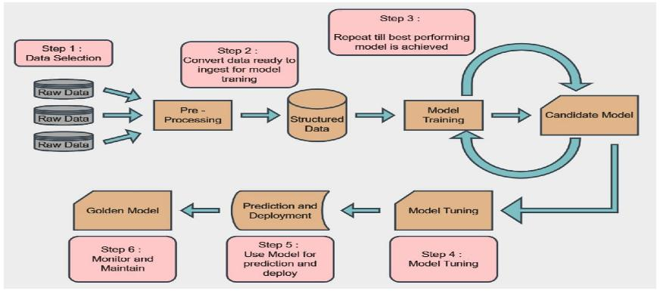
System Architecture

Slide 7
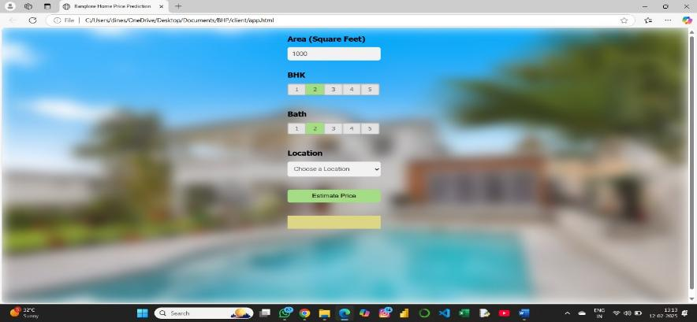
Live Demo of Project

Slide 8
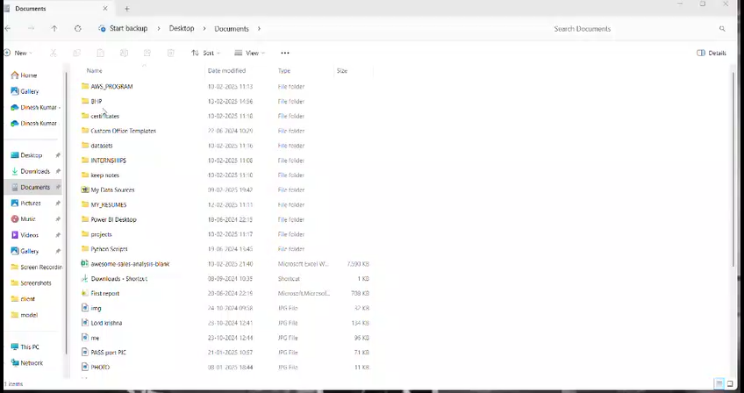
Video of Project Demo

Slide 9
GitHub: Click here for GitHub link Recorded Demonstration link: Click here for Video Demonstration link

Slide 10
Conclusion
In conclusion, house price prediction leverages machine learning algorithms to analyze various property features, location data, and market trends, enabling accurate estimations of potential selling prices for homes, empowering buyers and sellers to make informed decisions based on a more precise understanding of a property's true value in the real estate market; key factors impacting price include square footage, number of bedrooms, location, and current market conditions, with models like linear regression and Random Forest often used to generate these predictions.
Overall, house price prediction provides valuable insights for real estate professionals and potential buyers by offering a data-driven perspective on property valuation, allowing for more informed decision-making. Overall, house price prediction provides valuable insights for real estate professionals and potential buyers by offering a data-driven perspective on property valuation, allowing for more informed decision-making.

Slide 11
Future Scope
The future scope of house price prediction is expected to see significant advancements through the integration of sophisticated machine learning techniques like deep learning, ensemble methods, and hybrid models, allowing for more accurate predictions by incorporating large datasets including real-time market data, economic indicators, and social factors, providing valuable insights to real estate investors and market analysts.

Slide 12
Thank you!
Notes:
thank you very much for joining this PPT, keep learning.
12

